Slide 1
Auto dataset
Deepa Prakash

Slide 2
Challenges faced:
Pricing in the automobile industry is always a challenging task because the customers always look for the best of the features in a car that are affordable and most of the brands try to place themselves in an area where their brand packages these most desired features in a car with most competitive prices.
Problem formulation:
Determining pricing based on transactions, these transactions have few features such as date_of_sale, brand, number of units sold across different cities and location, how soon the delivery of the purchase expected which shows demand.

Slide 3
Data Preparation

Slide 4
Data Preparation
Filter data based on the type of sale as ‘Retail’
Altered column names to increase the readability.
Identified numerical and categorical variables, there are approximately 20 categorical variables with 2 continuous variables.
Huge chunk of feature color had .(dot), assuming most favored color as Black, replaced values to 'Black' to increase the readability

Slide 5
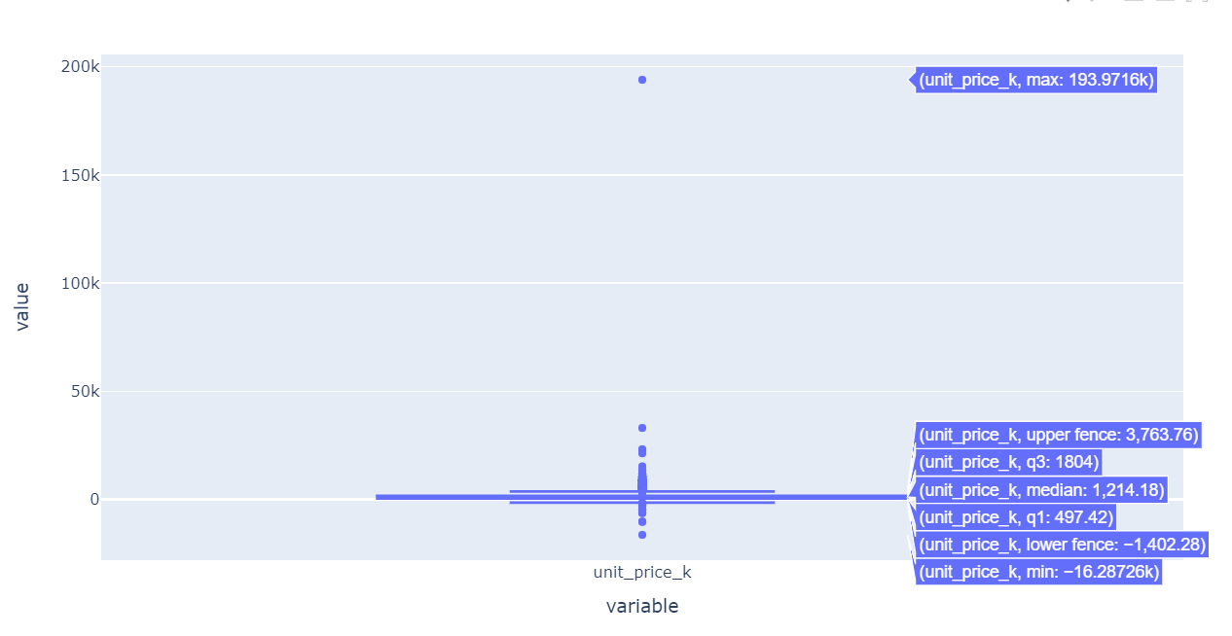
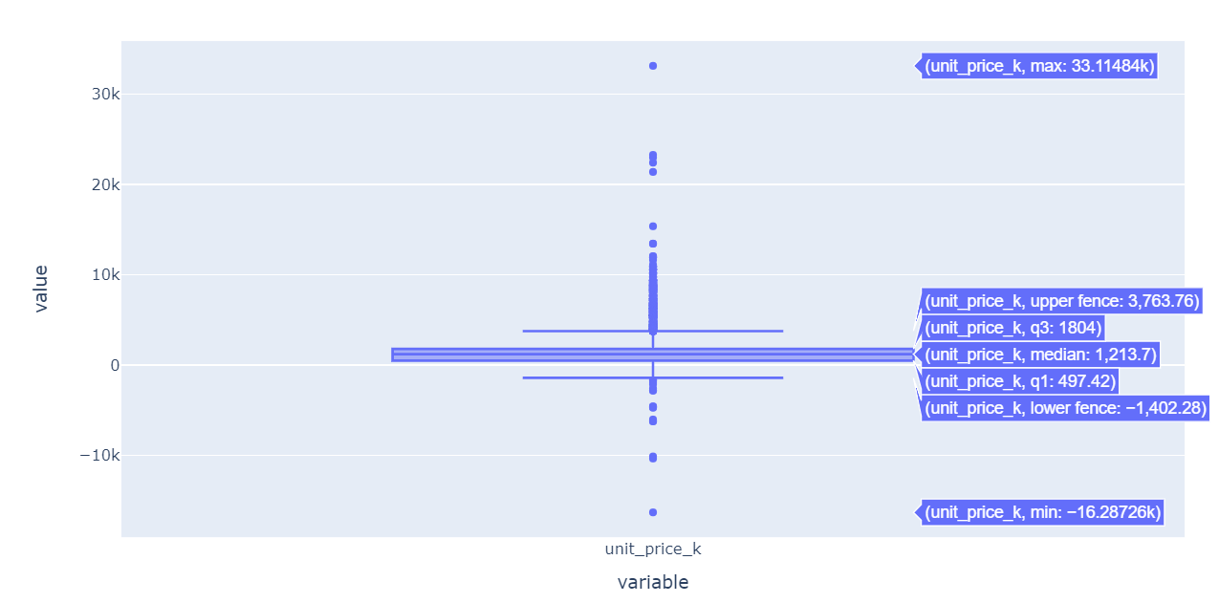
Missing values : No considerable missing values found, filled the null values with their respective mode values( frequently occurring values)
Outliers: A single record observed with an extreme high price which was an influence of the price distribution and was dragging data to extreme ranges and mean value would increase drastically. Since the presence of this ‘brand’ which is 'Aspark7' are more frequent in ‘wholesales’ type of sale not in retail, eliminated that record.
Attaching screenshots of boxplots for unit price($000) before and after outlier treatment, the graph on the left hand-side shows distribution with the influence point whereas the right hand-sided graph is the box plot after removing the influential point

Slide 6
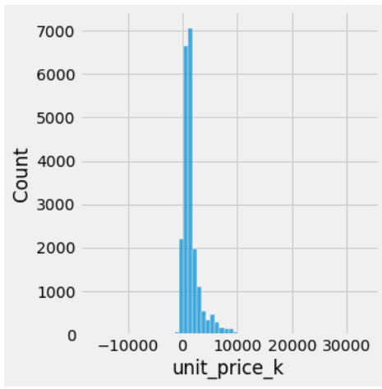
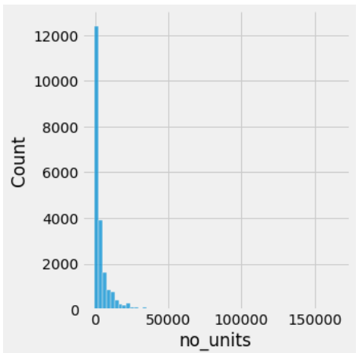
Univariate Analysis
Univariate distribution of 2 continuous variables which are unit_price_k and no_units. Both these variables are right skewed.

Slide 7
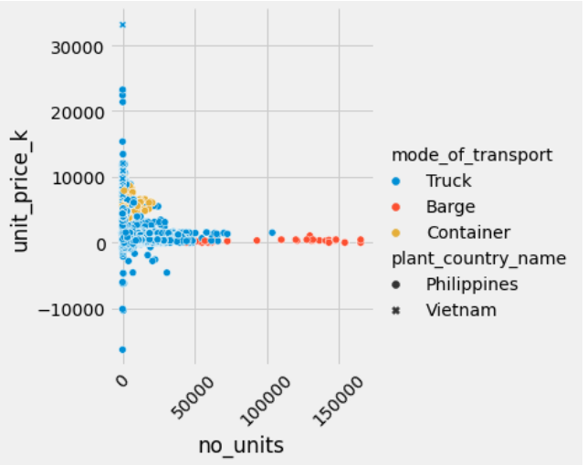
Bivariate Analysis
Interaction of 2 continuous variables which are unit_price_k and no_units shows that high value cars seldom make considerable sales, mid range cars have reasonable sales .
Graph shows a high demand for cheaper cars.
Unit price shows negative values, these are the cars that had no sales, keeping this data, so that we factor in the loss so that in future we can predict models that are loss making.
Most of the high volume cars are transported through “Barge” (sea transport, so makes sense)

Slide 8
EDA and few insights

Slide 9
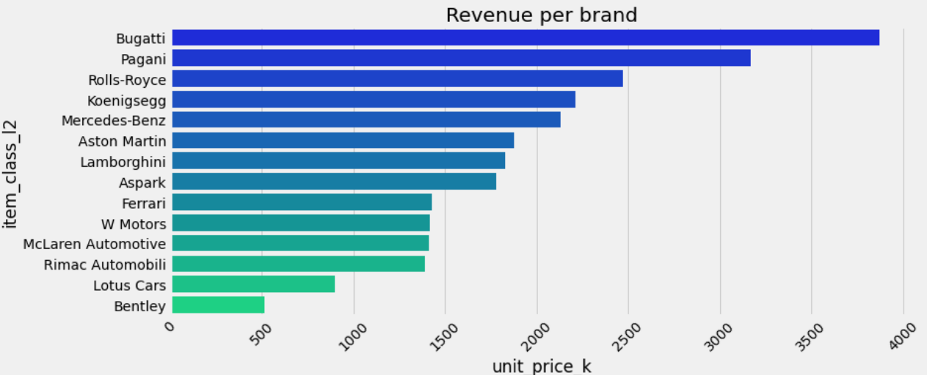
Profit Making Brands

Slide 10
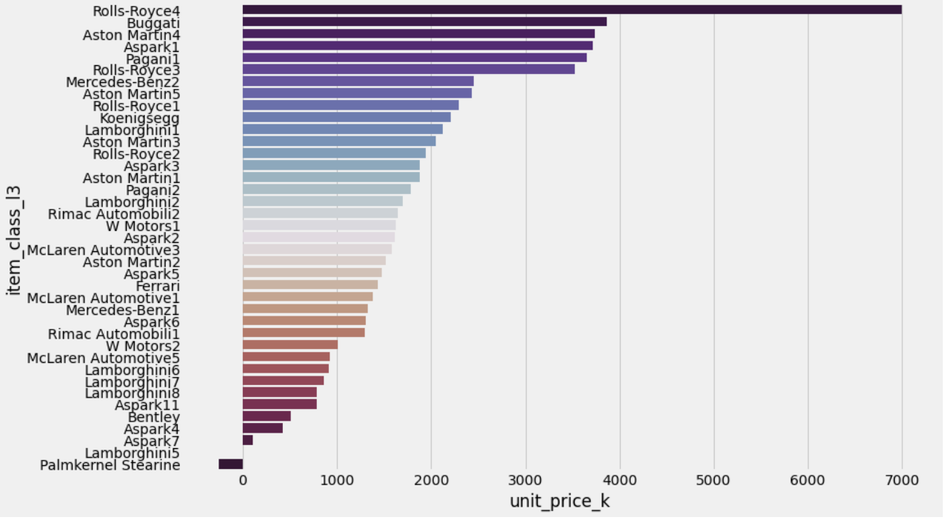
Profit making models

Slide 11
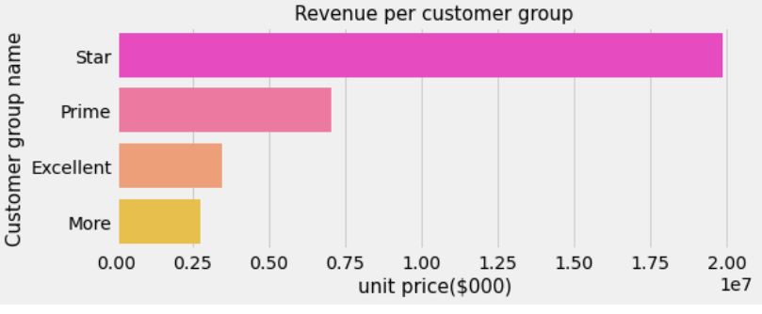
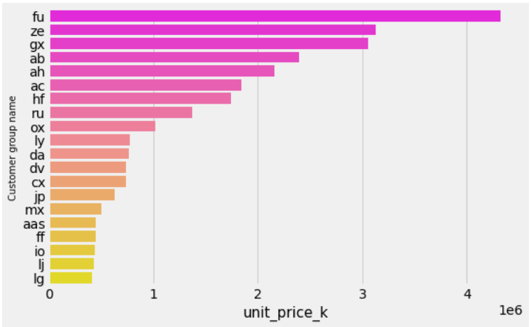
Customer segments price comparison
Customer group price comparison

Slide 12
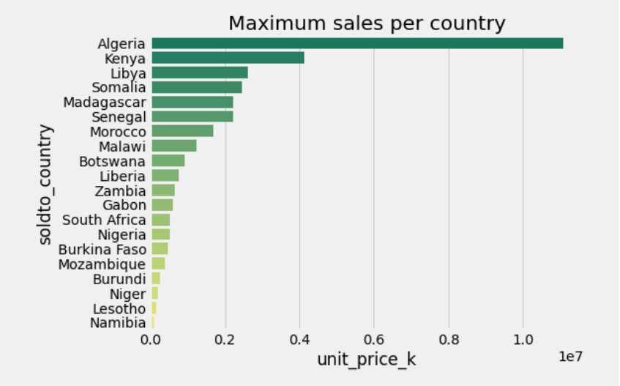
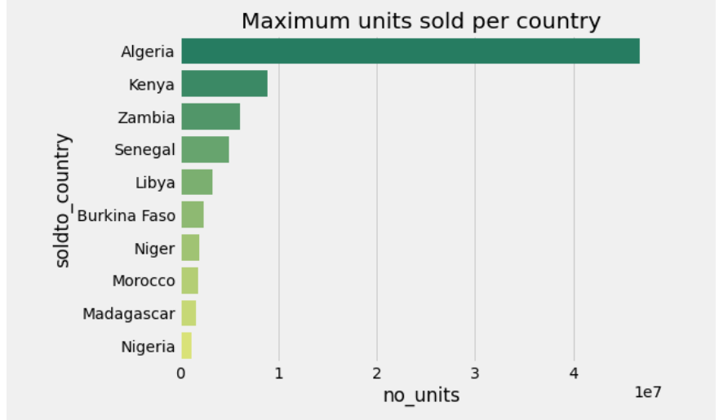
Revenue per Country and units sold per Country

Slide 13
FEATURE ENGINEERING

Slide 14
Categorical variables were converted to numeric values using factorize method, which converts the textual values into numeric values.
Created variables day, month and weekday from the feature date_of_sale.
Generated features rolling_mean_t7, rolling_mean_t30, rolling_mean_t90, rolling_mean_t60, rolling_mean_t90 , rolling_mean_t180 which gives the unit price means for the last 7 days, 30 days and so on.
This feature will help in evaluating the recent transactions importance.
Next, lets move on to the model building and addressing different hypothesis tests.
** Time series analysis was not considered because no seasonality was observed and the data provided was only for 2 years .

Slide 15
Model building

Slide 16
Approaches taken for the model building and the reasoning behind it.
OLS model with raw features generated in the EDA step to create a baseline model.
OLS model with introduction of dummy variables to for 2 categorical values item_class_l2 and month. These 2 categorical were chosen because, from the summary statistics of the baseline model and evaluating VIF to eliminate multicollinearity, these 2 variables had more prominence and we had to study the impact of the car brand and car model value on the pricing.
CatBoost model, as the name suggests it’s a boosting algorithm and manages the categorical variables with minimal data preparation.
XGBoost model, created a separate streamlit app to train and test model.
Let’s see which of these performs better and explain the different hypothesis tests. Note that, I have used OLS model to extract the impact of predictors on the output variable and shap values were extracted from the CatBoost model to prove the hypothesis.

Slide 17
Hypothesis

Slide 18
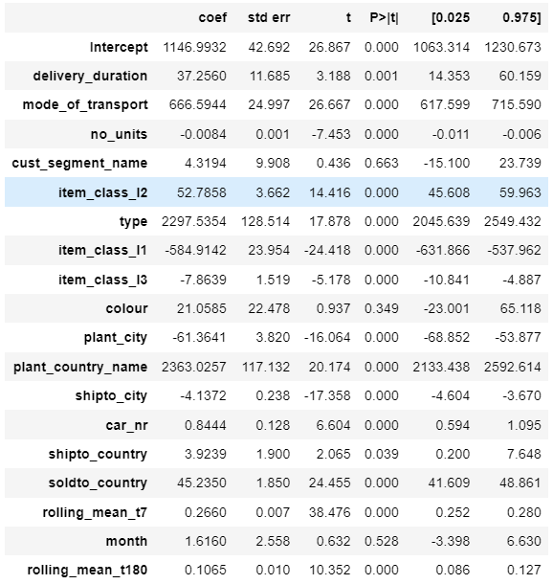
Hypothesis 1
Variables item_class_l2 and item_class_l3 represents brand and the actual model respectively.
Let us evaluate their impact on the pricing thus determining if they are to be considered in the pricing strategies.
-Considering OLS model followed by mining out important features that push the dependent variable in the positive direction we can conclude that item_class_l2 has more positive influence on the pricing, whereas item_class_l3 has a negative impact, meaning, the every unit increase in item_class_l3, brings down the unit price by -7.86 k
Whereas item_class_l2 has a positive impact on the pricing, every unit increase in item_class_l2, price increases by 52.78k, which is good factor to consider for pricing strategies.

Slide 19

Hypothesis 2
Null hypothesis: Ho : Unit price is not impacted by recent purchases.
Alternate hypothesis: Ha : Unit price is impacted by recent purchases
In order to test this scenario, we will have to look at the recent purchases made by the customer and measure their impact on the unit prices, looking at the model statistics and measuring their significance, it can be concluded that recent transactions have higher weightage or explanability on the dependent variable(unit_price). Please refer the screenshot below. When the model is regressed with recent transactions average prices of 7,30,60,90,180 days, it shows that price goes up by .266k units for every unit increase in the recent transactions made in 7 days.Intercept value is 1146.9932,

Slide 20
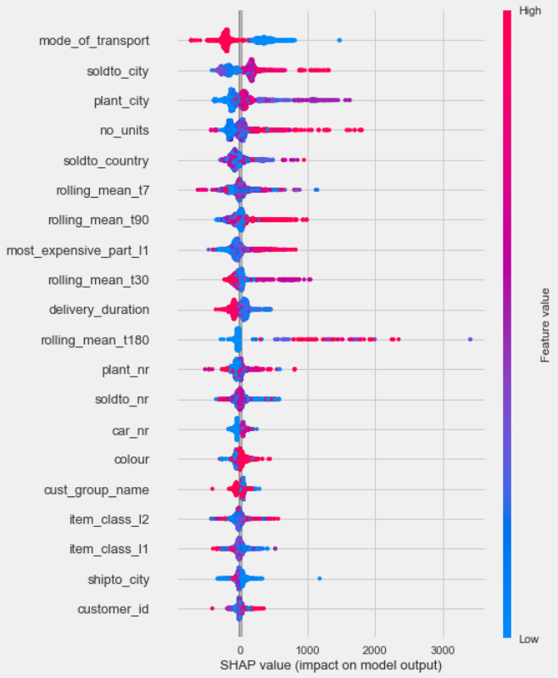
Hypothesis 2 contd…
Further, when I regressed it with catboost algorithm, I see that the variable rolling_mean_t7 has a higher influence than the old transactions.
We can clearly conclude that the recent transactions do have an impact on the pricing, where as old prices are not to be considered as they have a negative push to the dependent variable.

Slide 21
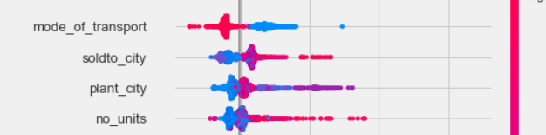
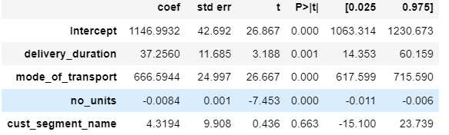
Hypothesis 3:
Pricing differs depending on size of customer (i.e size of their past purchases in terms of volume or total spend- they are not sure which one)
Looking at the OLS model summary, we can conclude that the number of units (volume) does not really have a significant effect on the pricing.
We can further look at the shap value model explanation , where the number of units sold have a negative influence on unit prices.

Slide 22
Hypothesis 4:
The price that a customer last paid for a car is an important factor in pricing. Few colleagues say that they first estimate a price based on gut feel and then compare their estimate against the last price the customer paid for the same product. In case the last price is higher, they go with that and not the price they estimated.
Recent transactions shows higher prediction power for pricing,
lets look at how the difference between actual and the predicted values look like for each model.
Difference between the actual and predicted values in the catboost model shows we are over-estimating the values marginally, please keep in mind we have regressed this model with recent transactions metric which already suggests that the predictions are based on the estimates and not on any other basis.
Model | Revenue difference b/w actual and predicted
OLS Baseline | 16946.04
OLS with Dummy variables | 14744.82
Catboost | -9124.40

Slide 23
Model Evaluation
Model | R square | Adjusted R Square | RMSE
OLS Baseline | 0.449 | 0.448 | 1296.58
OLS with Dummy variables | 0.5 | 0.499 | 1232.35
Catboost | 0.91 | NA | 542.26
XGBoost | 0.91 | NA | 545.10
Please note the R2 , RMSE for Catboost model. Hence, we can conclude that gives the best performance out of the 3 models.

Slide 24
Model Explainability using shap values
Shap values are pivotal in understanding the model output interpretation, it shows how significant are the predictors thus helping us understand the features that are a value add to the model.
Lets have a look at some plots and try to deduce the model output from each of these contributing factors

Slide 25
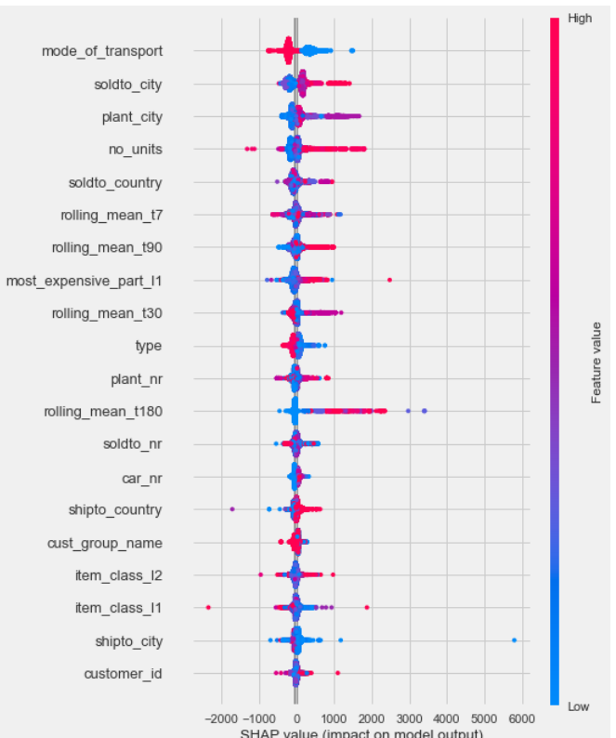
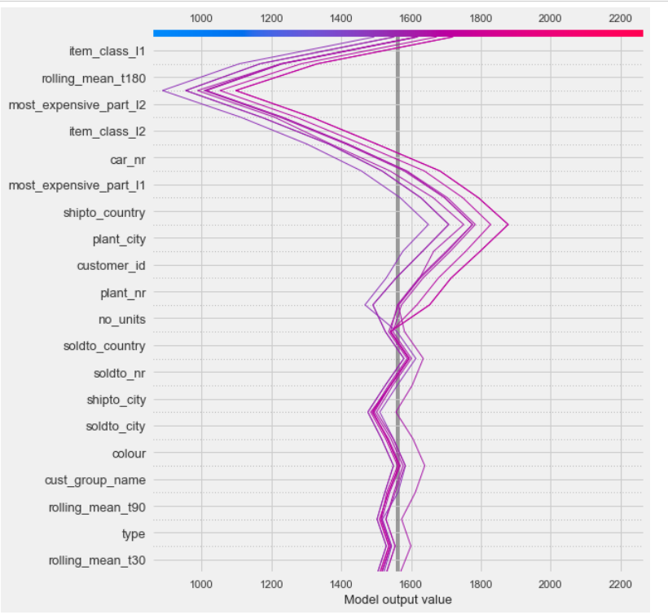
Summary plot and decision plots
Summary plot shows the relationship between the value of a feature and the impact on the prediction.
The x-axis represents the model’s output. In this case, the units are log odds.

Slide 26
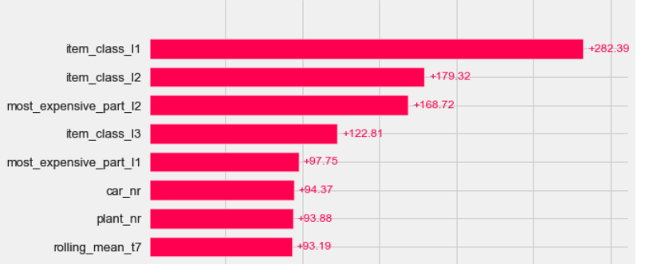
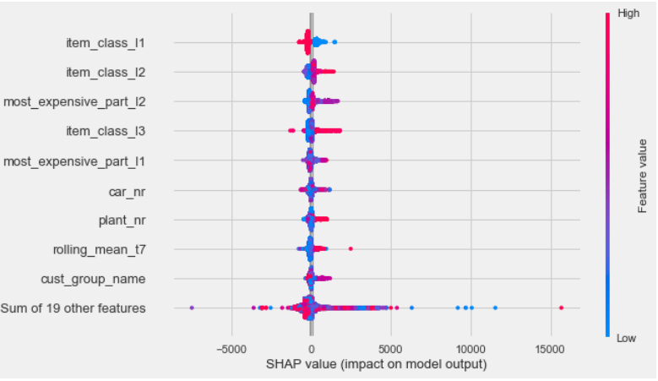
Further, the shap plots from the catboost algorithm suggests a positive push for the variable item_class_l2 and item_class_l3, suggesting both the brand and the brand model are an influence on the model output.

Slide 27
Customer segmenTation

Slide 28
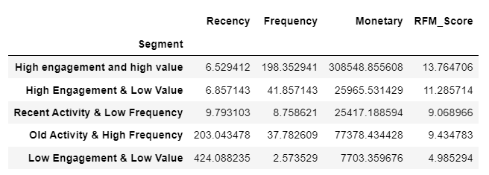
Customer Segmentation
We can use the Recency, frequency and Monetary(RFM) model to understand the customer engagement and high revenue generation, where high engagement, and most recent customers have higher revenue generation than the others.

Slide 29
Further Enhancements
There are a considerable cars that are not sold and hence loss making, causality analysis can help deducing the reasons for no sale and try to strategize the manufacturing of such cars.
Customer segmentation can be expanded more to have a more focused groups such as high risk customers, lazy customers for target marketing and high value customers group identification to reward them and keep them from leaving.
Any pricing strategy will hold good in an environment that the markets are already familiar with, if we have features that indicate any external influences like the pandemic, inflation it will be easier to estimate demands and control pricing accordingly.

Slide 30
THANK YOU

